Slide 1

S/4HANA Output Management #SAPStammtischIndia
Gaurav Karkara
May 2021

Slide 2
Agenda
S/4HANA Output Management
Introduction – What?
Why?
Development
Steps we take
S/4HANA Output Control vs Traditional Framework
Scope
What should S/4HANA customers consider

Slide 3

S/4HANA Output Management

Slide 4
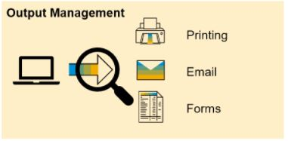
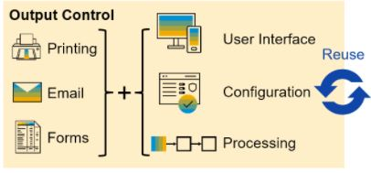
S/4HANA Output Management – Management/Control
Vs

Slide 5
S/4HANA Output Management – What?
Extensibility
One for All
Supports Standard Extensibility for configuration and documents(Form & email templates)
Unified solution for all output-related tasks across the product
Ready-to-use
Environment
Pre-delivered configuration for common scenarios/applications
Runs in both – On Cloud and Premise editions
Business User Enablement
Monitoring
Enable business users to perform all relevant output-related tasks
Central monitoring tools for Key users

Slide 6
S/4HANA Output Management – Why?
Native Integration to Fiori Apps (SAP GUI as well)
Separation of Static layout and content
Cloud Support
Standard Extensibility Support
Pre-delivered Content

Slide 7
Development

Slide 8




Development – Key Messages
Can I only use Adobe forms in S/4HANA?
Can I still use existing smart forms when moving to S/4HANA?
The respective edition of S/4HANA defines which forms technologies are available
Per edition, the individual business application decides on available output options
In each output solution, one or more form technologies can be used
Individual business application decides the output and form technology options.

Slide 9
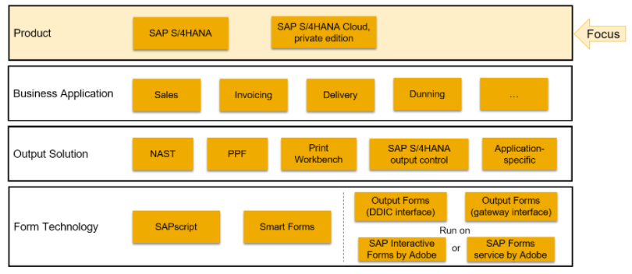
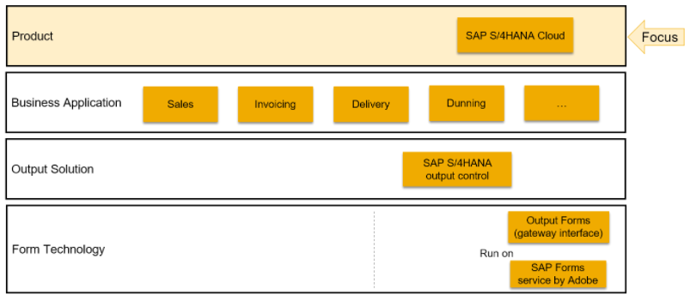
Development

Slide 10
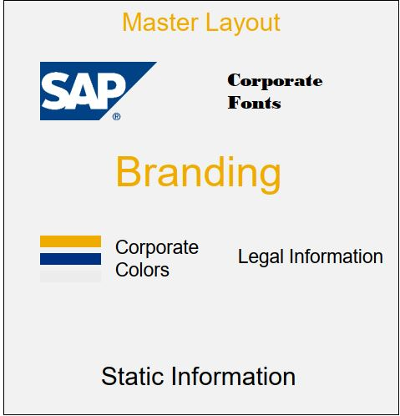
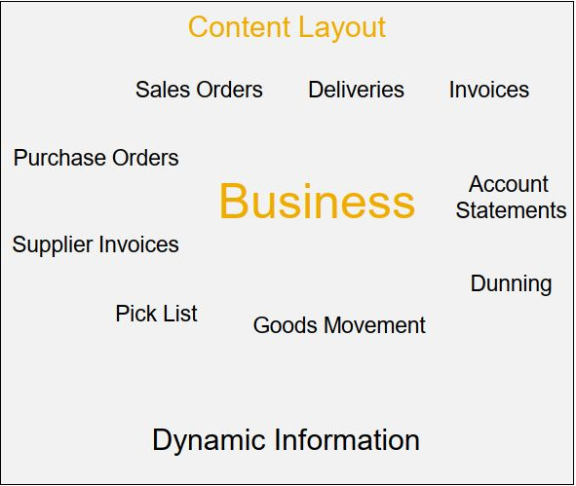
Development – Gateway-based Forms, Master/Content Layout
Backend Access not required
ADLC – Local Development
Fiori-enabled
DS: Gateway

Slide 11
Development – Steps we take
Maintain Form Templates
Form Configuration - OPD
Output Configuration
Master Form Config
Download Form template – XDP, XSD and Master layout files. Local level changes. Upload file. Create new template
Make Change as required & Upload
Search Form Name for Output Type, Configure Output Types, All functions related to output like PRINT, EMAIL. We assign custom form templates, email templates to output type here along with many other settings.
Output Parameter determination, Manage/Configure your solution -> Assign Form templates
Assign Master Form Template to Form Template based on various conditions. Various Conditions could be based on Company Code, Purchasing Organization, Plant & Sales Organization.

Slide 12
S/4HANA OM vs Traditional Frameworks

Slide 13
S/4HANA OM vs Traditional Frameworks - Scope
S/4HANA OM
Traditional Frameworks
Printing ( Only Print forms)
Email ( With added flexibility)
EDI ( Outbound to business receivers from transactional applications, not using ALE)
Printing ( Print forms, Interactive)
Email ( With less flexibility)
EDI, IDoc ( using ALE to determine business partner)
Workflow
Integration
Special Functions
Cheque Print – Choose Tray functionality

Slide 14
S/4HANA OM vs Traditional Frameworks – What should S/4HANA Customers consider
It is not mandatory for customers to switch to SAP S/4HANA output control.
Default is still the existing output solution.
The scope of SAP S/4HANA output control includes output-only functionality.
Switching business applications from specialized or generic frameworks to SAP S/4HANA output control might lead to loss of functionality.
Customers can test out SAP S/4HANA output control for existing applications. Productive usage shall only be considered if scope and functionality of SAP S/4HANA output control fits to the customer requirements.
Is customer going to work with lot of new applications/modules.
Is there any roadmap to move to S/4HANA Cloud (Essentials) version?
Is customer okay to add extra framework to list of output management solutions (if legacy ones are still to be supported).
There are no plans to deprecate functionality.
No mandatory actions for OP customers/ Entire old scope of traditional options still available.

Slide 15

YOU HELD THROUGH !
Thank You

Slide 16
References
https://blogs.sap.com/2021/04/26/output-management-in-sap-s-4hana/
https://blogs.sap.com/2018/03/12/extend-form-template-using-sap-s4-hana-cloud-in-app-extensibility/
SAP Community - https://blogs.sap.com/tags/73555000100800000066/

